Slide 1


Downstream Analysis of RNA-Seq Results in R: GSEA, PPI Networks, and Biological Interpretation
Francesca Vitali, Ph.D.

Slide 2
CLASS SUMMARY
Enrichment analysis
Hands-on: use R for Enrichment analysis
Build Protein-Protein Interaction (PPI) Networks to explore functional connections between genes.
Explore drug repurposing opportunities based on RNA-seq data.

Slide 3
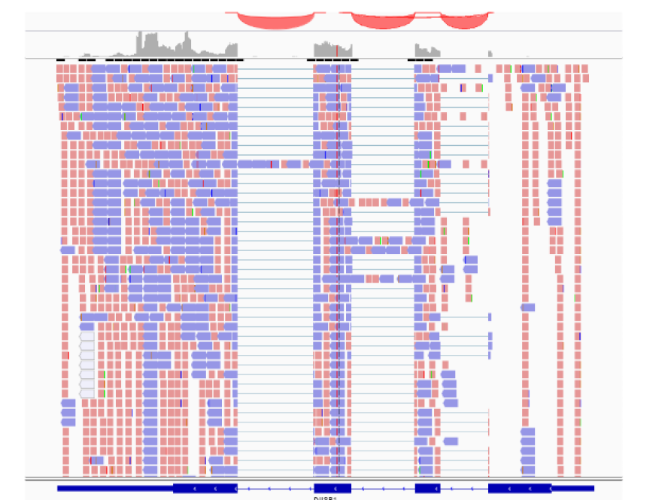
RNAseq
QUANTIFY GENE EXPRESSION

Slide 4
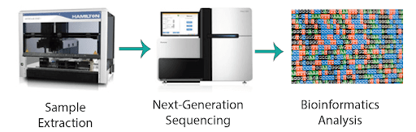
RNA-seq

Slide 5

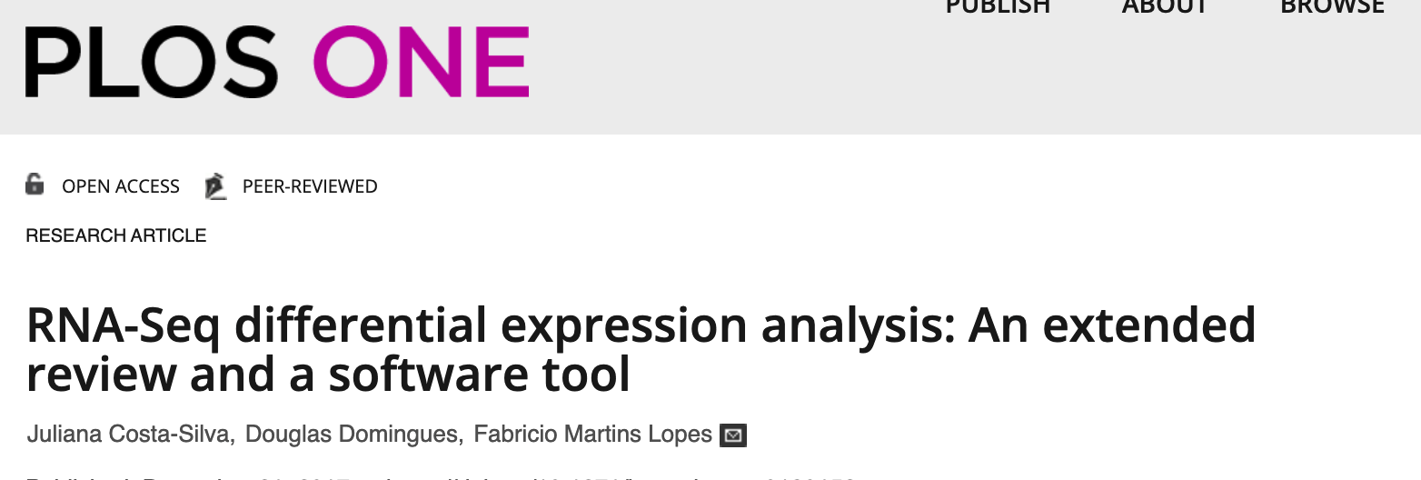
DIFFERENTIAL EXPRESSION ANALYSIS
DIFFERENT PACKAGES AND ALGORITHMS ARE AVAILABLE
Limma
edgeR
DESeq
DESeq2
…
Determine which genes have significant expression change under a condition (disease vs control, treatments, etc)
OUTPUT
List of genes
Differential expression (Fold Change)
P-values

Slide 6

ENRICHMENT ANALYSIS
INPUT
List of genes
Differential expression (Fold Change)
P-values
1. Overrepresentation Enrichment
2. Gene Set Enrichment Analysis (GSEA)
Choose a threshold of expression difference to select DIFFERENTIALLY EXPRESSED GENES - DEGs
(e.g. |LogFC|<2 and p value< 0.01)
Perform the enrichment on the list of DEGs
Perform the enrichment on all the genes and their fold change values

Slide 7
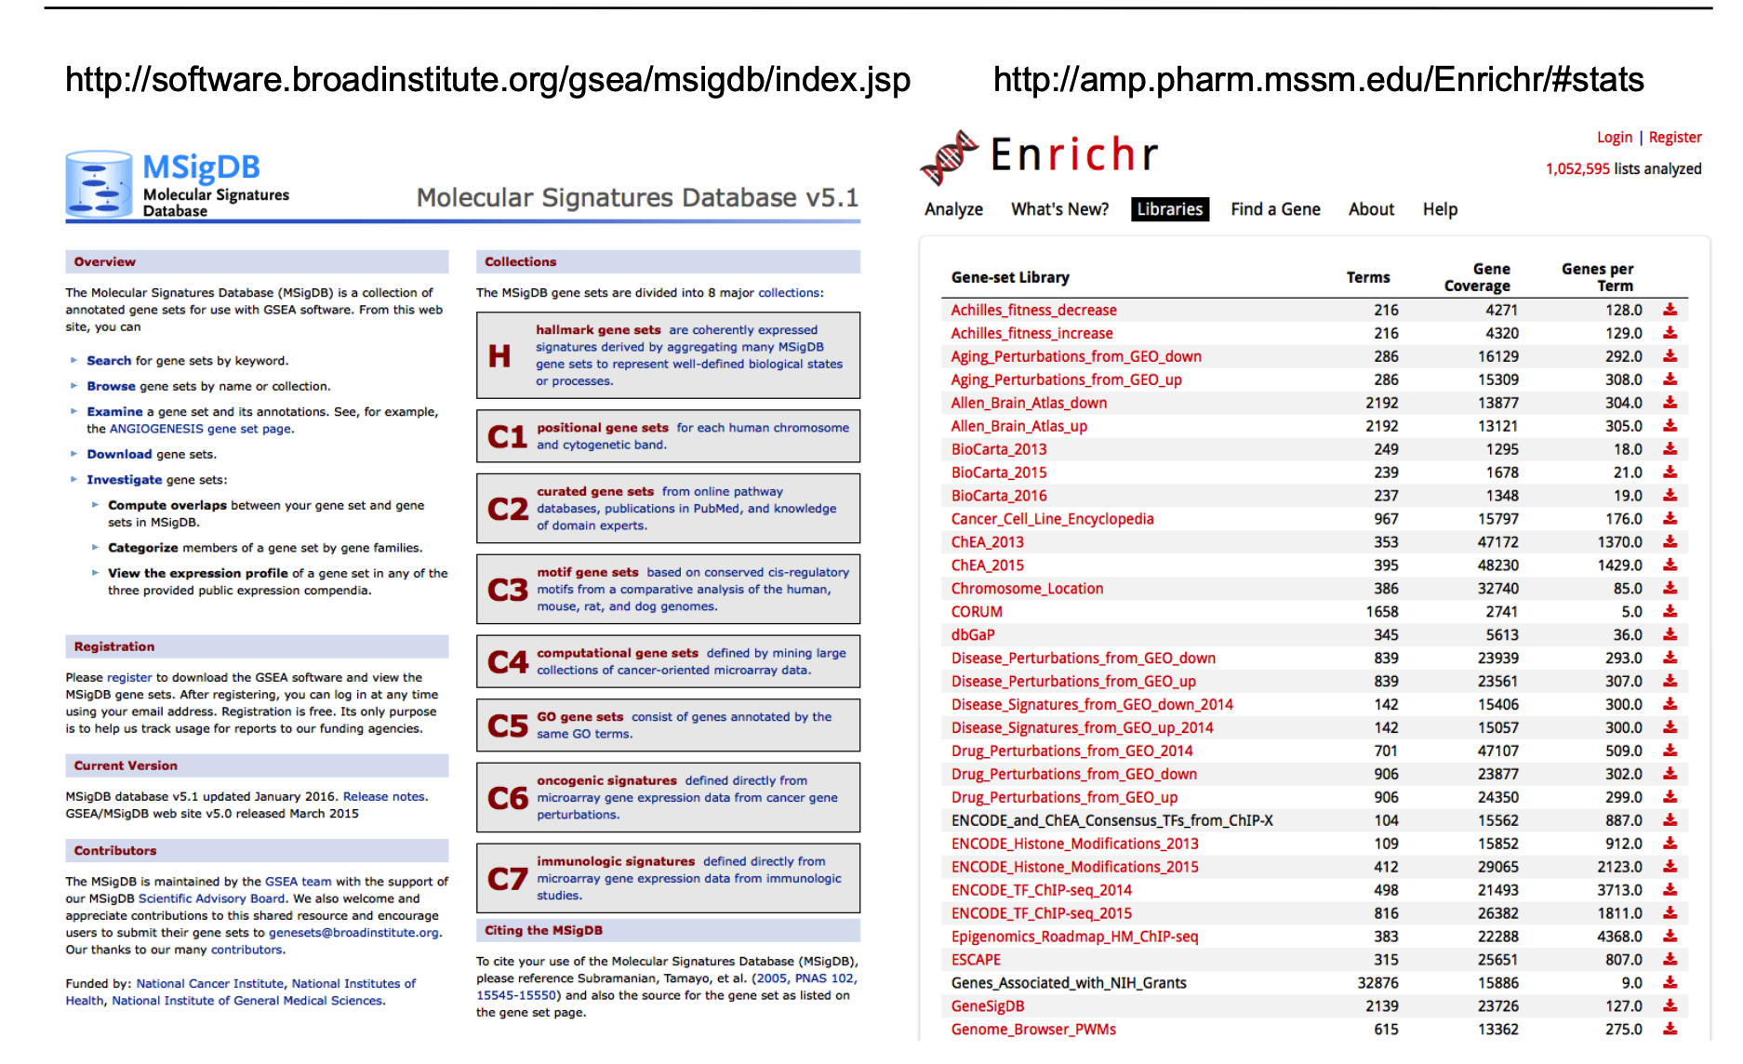
Gene Sets

Slide 8

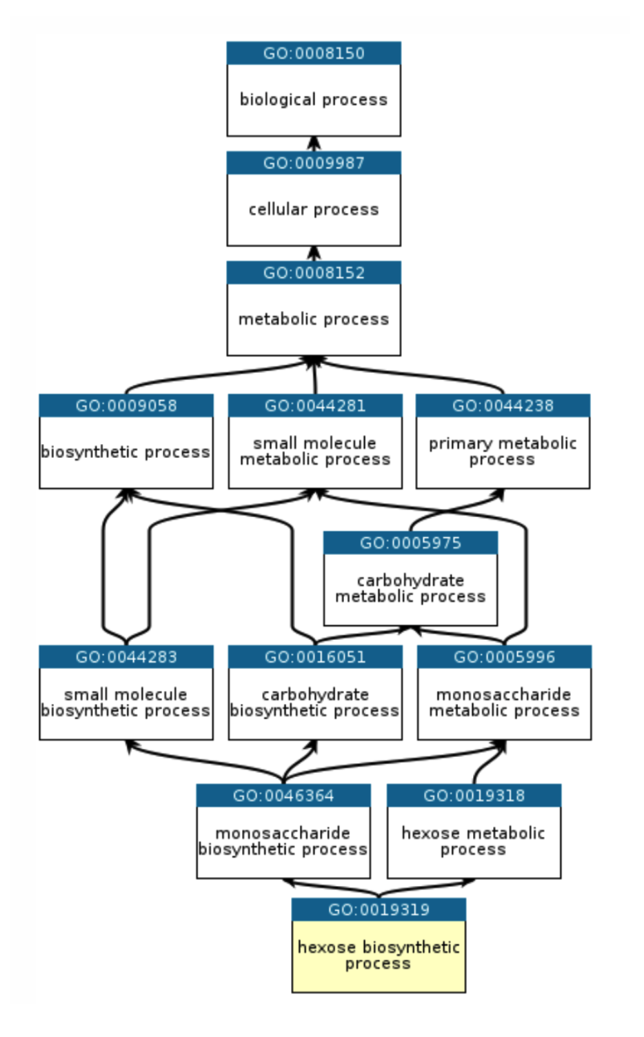
GENE ONTOLOGY ENRICHMENT ANALYSIS
The Gene Ontology (GO) knowledgebase is the world’s largest source of information on the functions of genes.
Genes are associated to:
Biological Process (BP)
Molecular Function (FF)
Cellular Component (CC)

Slide 9

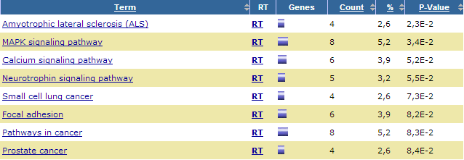

1. Overrepresentation Enrichment : Fisher’s test
START FROM A LIST OF GENES - DEGs
Hypergeometric distribution
p value = probability of obtaining the observed configuration or a more extreme one
If I randomly extract 300 genes from ~30,000 (of which 40 are annotated with “p53 signaling pathway”)
What is the probability of obtaining at least 3 genes annotated “p53 signaling pathway”?
 | DEG | Genome
IN the pathway | 3 | 40
NOT IN pathway | 297 | 29,960
https://david.ncifcrf.gov/home.jsp
https://maayanlab.cloud/Enrichr/

Slide 10
1. Overrepresentation Enrichment : Fisher’s test
 | DEG | Genome
in the pathway | 3 | 40
Not in pathway | 297 | 29960
Requires a cutoff (arbitrary) – based on Fold change or p-values
Not accounts for the values of the gene-level statistics
Good for overlap of significant genes in two comparisons
Computationally fast

Slide 11
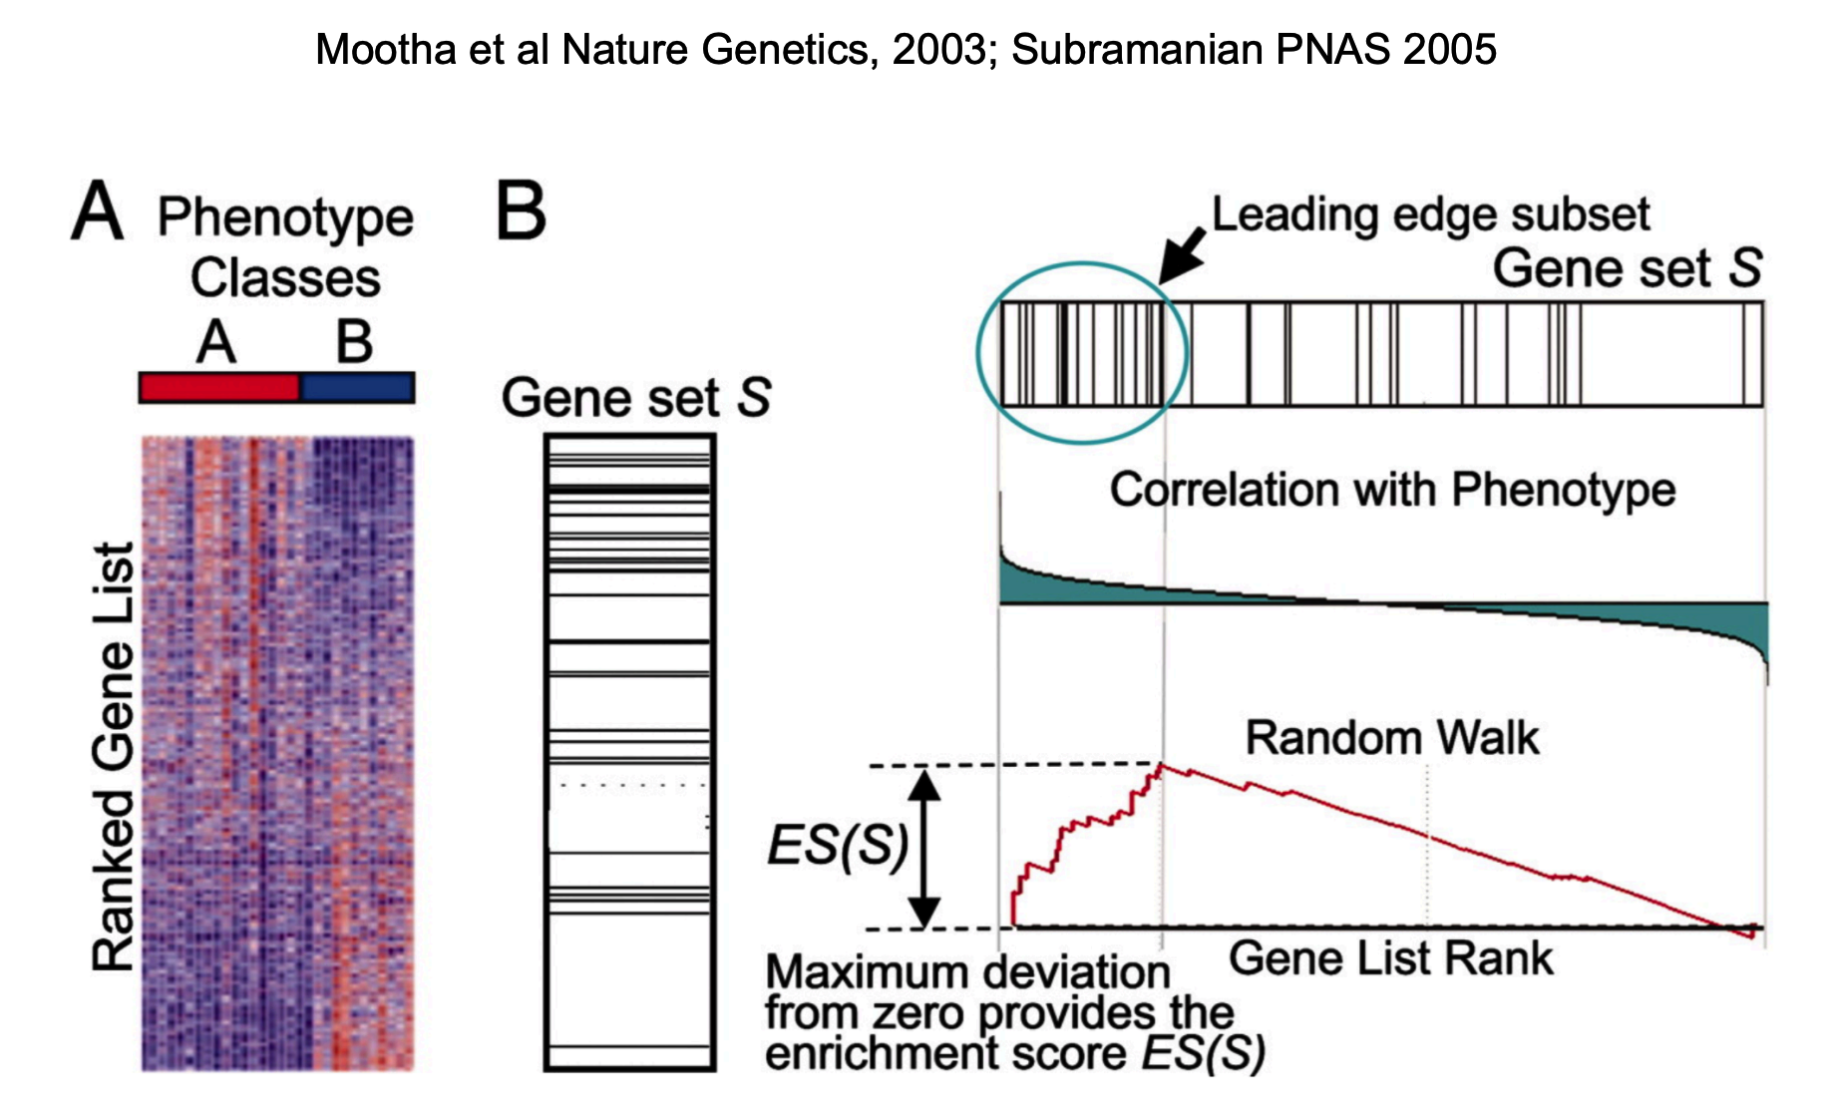
2. Gene Set Enrichment Analysis (GSEA)
Gene-set analysis is cutoff-free
Uses all gene-level data
Can detect small and coordinate (same direction) changes that collectively contribute to biological processes

Slide 12
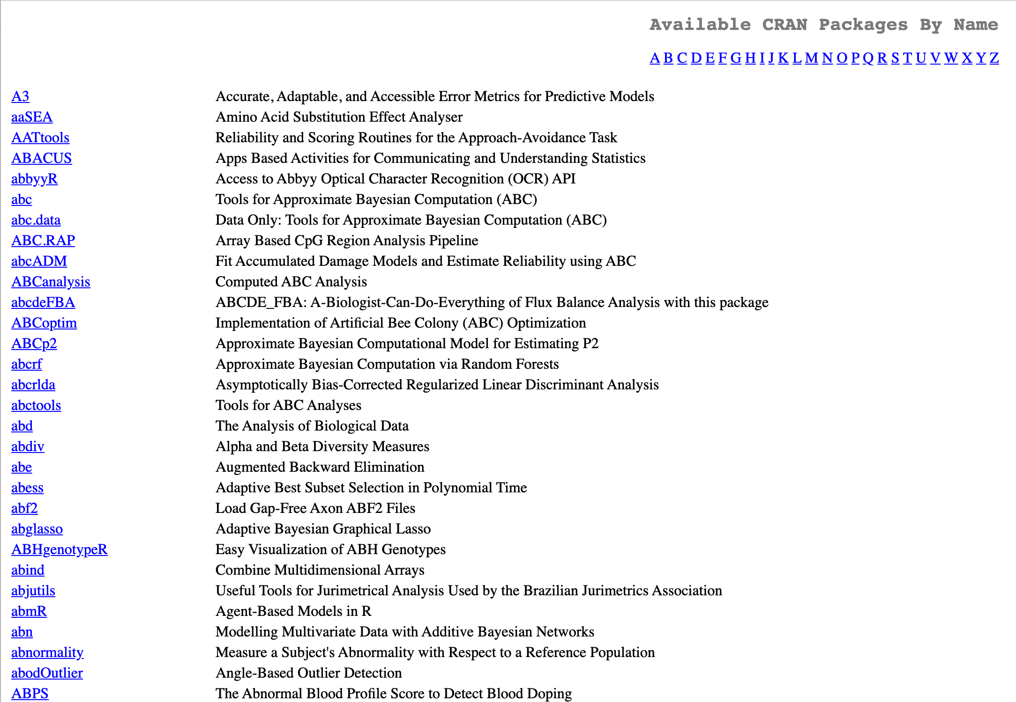

R packages
R packages contain code, functions, data, and documentation in a standardized collection format that can be installed by users of R, typically via a centralized software repository such as CRAN (the Comprehensive R Archive Network).
library(clusterProfiler)
https://yulab-smu.top/biomedical-knowledge-mining-book/index.html

Slide 13
EXERCISE
Pathway-Enrichment Analysis
with R

